Slide 1
MRM Business Model
MRM Steering Committee
April 29, 2011
2011-04-29
MRMv2 Steering Committee

Slide 2
Business Model Working Group
We believe that this business model addresses the short term viability and sustainability of the MRMv2 products and services.
Further work on the long term vision and growth strategy needs to be completed after “testing the market” with the initial release of the product.
2011-04-29
MRMv2 Steering Committee

Slide 3
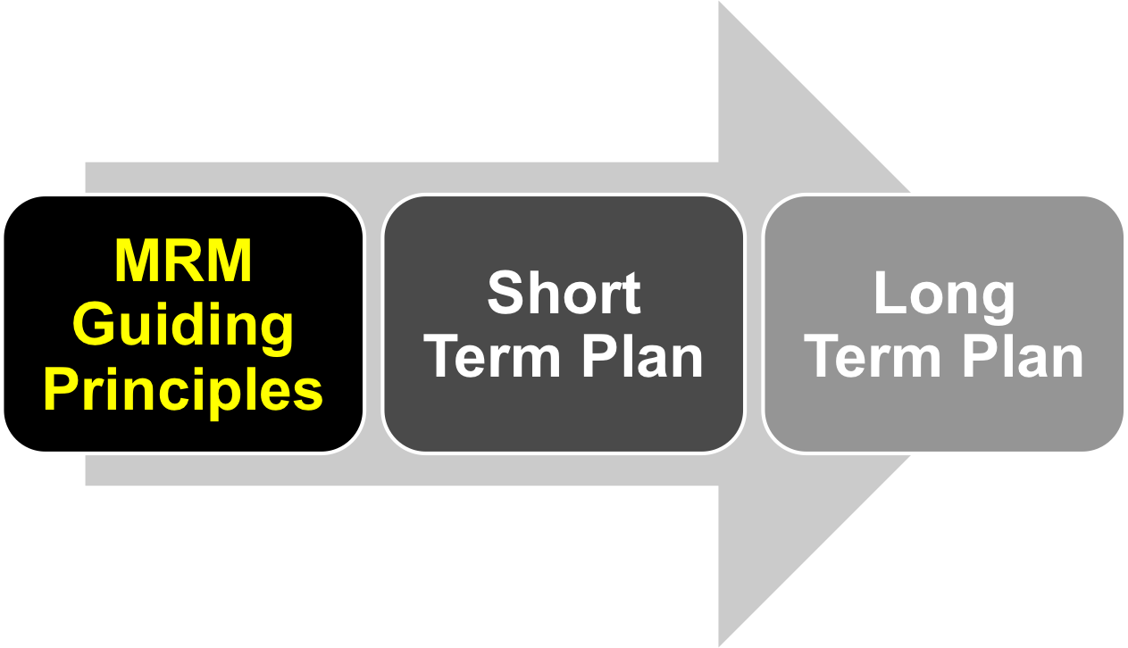
MRM Business Model
2011-04-29
MRMv2 Steering Committee

Slide 4
MRM Guiding Principles
Enable MRM to become a widely adopted
and endorsed de facto standard for
municipal services modeling.
Ownership remains with MISA, which
includes intellectual property rights,
administration, development, maintenance,
support, promotion, etc.
Non-profit. Available to municipalities (MISA Members) at minimal cost.
2011-04-29
MRMv2 Steering Committee

Slide 5
MRM Guiding Principles continued
Support the initial participants to be
successful in leading the pack and
demonstrating the value of adopting the
standard.
Distinction between the pioneers who
contributed significantly and the late
comers to be considered, but the financial
limitations and challenges of different
municipalities have to be recognized.
2011-04-29
MRMv2 Steering Committee

Slide 6
MRM Guiding Principles continued
Services provided are the same regardless of the size of the municipality.
A short term Business Model (initial 12
months to 18 months) is required to address
the immediate needs in launching the
services; a long term Business Model
is required to address future needs in sustaining and furthering the services.
Admit private sector participation, not
immediately but in the future.
2011-04-29
MRMv2 Steering Committee

Slide 7
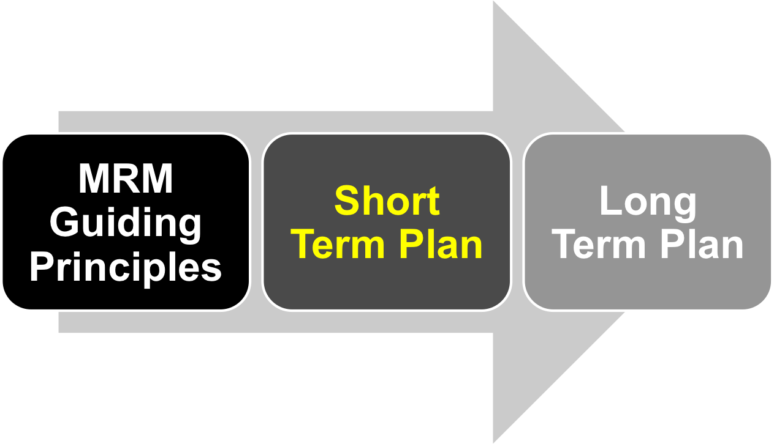
MRM Business Model
2011-04-29
MRMv2 Steering Committee

Slide 8
Short Term Plan
In return for their initial investment, based on a fee schedule outlined below, municipal subscribers will receive for a period of two years a core set of services which include:
  Access to MRM website for use of tools (already developed);
  Content: meta-model, reference model, use cases, as implemented with the IBM software (System Architect);
  User Guides and instructions on both the MRM principles and use of the software
  Collaboration with other subscribers (access to other municipalities’ published models);
  Initial training on use of the tools;
  Further enhancements to both content and the implementation within the software, as may be developed over that time
2011-04-29
MRMv2 Steering Committee

Slide 9
Short Term Plan: continued
At this time, it appears likely that sustainment and continued development of the service after the first two years will require an annual subscription fee to cover operating costs and to maintain access to the services
The need for such an annual subscription fee, and the amount of such a fee (assumed to be a fraction of the initial investment), will be confirmed as part of the longer term Business Plan.
Options which can avoid or reduce the need for such an annual fee will be explored.
2011-04-29
MRMv2 Steering Committee

Slide 10
Short Term Plan: continued
Ongoing support:
  First level being provided by the website
  vendor, e-Solutions, should continue at
  least for the next 9 – 12 months.
  Second level of support (subject matter expert) to be provided by volunteer resources
  Make use of collaboration forums where questions can be posed and volunteers will commit to monitor and provide answers
2011-04-29
MRMv2 Steering Committee

Slide 11
Short Term Plan: User Benefits Package
Publicly Available: MRM meta-model; Quick Reference Guide
Full Subscribers
  Modeling Principles Handbook
  Authoritative Reference Model
  Access Quickr Collaboration Site (unlimited) and System Architect (10 hours/month for each $5,000 contribution)
  Access Published “My Municipality” Models on Quickr Site and in System Architect
  MRM Introductory Training (half-day) and System Architect Training (one day)
    One attendee per $5,000 contribution
    Discounted rate for additional attendees
  Participate in MRM Standards Board
  Participate in MRM System Architect User Group (identify and prioritize enhancements)
Content Only Subscribers
  Modeling Principles Handbook
  Authoritative Reference Model
  Access Quickr Collaboration Site (unlimited)
  Access published “My Municipality” Models on Quickr site
  MRM Introductory Training (half-day)
    One attendee per $2,500 contribution
    Discounted rate for additional attendees
  Participate in MRM Standards Board
NOTE: The continued availability of the Content Only subscription will be reviewed as part of the longer term plan
2011-04-29
MRMv2 Steering Committee

Slide 12
Short Term Plan: Projected Cash Flow
 | Cash Flow Requirement | Projected Revenue | Surplus / (Deficit)
2011 | $27,177 | $40,000 | $12,823
2012 | $70,695 | $85,000 | $14,005
2011 – 2012 | $97,872 | $125,000 | $26,828
Notes: Excludes costs for:
Legal fees (MISA will cover for IP?)
Marketing and Promotion
Travel (for training, marketing, promotion)
Project Management
Administration and Support (other than e-Solutions)
2011-04-29
MRMv2 Steering Committee

Slide 13
Existing Contributions Summary
Population Range | # of Municipalities | Target per Municipality | Target Total | Actual Revenue
> 500,000 | 5 | $25,000 | $125,000 | $172,500
300,000 – 500,000 | 3 | $20,000 | $60,000 | $95,000
100,000 – 300,000 | 3 | $15,000 | $45,000 | $47,500
50,000 – 100,000 | 2 | $10,000 | $20,000 | $18,500
< 50,000 | 1 | $5,000 | $5,000 | $10,000
Joint Councils | n/a | n/a | n/a | $20,000
Total | 14 |  |  | $363,500
2011-04-29
MRMv2 Steering Committee

Slide 14
Existing Subscribers/Revenue
Municipality | Population | Pop. Range | Target | Total Contrib.
Toronto | 2,503,281 | > 500,000 | $25,000 | $37,500
Peel Region | 1,159,405 | > 500,000 | $25,000 | $32,500
York Region | 892,712 | > 500,000 | $25,000 | $32,500
Edmonton | 730,372 | > 500,000 | $25,000 | $60,000
Mississauga | 668,549 | > 500,000 | $25,000 | $10,000
Halton Region | 439,256 | 300,000 - 500,000 | $20,000 | $37,500
Niagara Region | 427,421 | 300,000 - 500,000 | $20,000 | $27,500
London | 352,395 | 300,000 - 500,000 | $20,000 | $30,000
Markham | 261,573 | 100,000 - 300,000 | $15,000 | $22,500
Saskatoon | 202,340 | 100,000 - 300,000 | $15,000 | $10,000
Richmond Hill | 162,704 | 100,000 - 300,000 | $15,000 | $15,000
Waterloo | 97,475 | 50,000 – 100,000 | $10,000 | $7,500
Fredericton | 50,535 | 50,000 – 100,000 | $10,000 | $11,000
Timmins | 42,997 | < 50,000 | $5,000 | $10,000
Joint Councils | n/a | n/a | n/a | $20,000
Total |  |  |  | $363,500
2011-04-29
MRMv2 Steering Committee

Slide 15
Expenditures to Date: March 31, 2011
Phase 1: Feasibility
Chartwell | $77,475.82 | Consulting, project planning, project mgmt
Team Travel | $6,336.66 | IBVA Process, attend IBM in Almaden
Meeting Expenses | $534.27 | Room booking and refreshments
Phase 1 Total | $84,346,75
Phase 2: Implementation
IBM Software | $181,041.96 | Rational Products, Lotus Quickr, DB2, Tivoli
Miller Thompson | $12,452.80 | Legal advice for IBM Relationship Agreement
Phase 1 Total | $193,494,76
Operating Costs
eSolutions | $54,786.54 | Set-up, hosting and support (18 months) – prepaid through to June 30, 2011
IBM Software Renewal | $20,794.18 | Renewal (maintenance for Quickr, DB2, Tivoli
Total Operating | $75,580.72
Grand Total | $353,422,23
2011-04-29
MRMv2 Steering Committee

Slide 16
Known Cash Flow Requirements:
April 1, 2011 – Dec. 31, 2012
Contributions to Date | $363,500
Expenditures to Date (March 31, 2011) | $353,422 | eSolutions paid through June 30
Unexpended Balance | $10,078
eSolutions 2011 (6 Months) | $15,425 | Due July 1, October 1 for Q3/Q4
IBM Software Renewal (Base Products) | $21,830 | Due Sept. 2011 (2010 + 5%)
Total 2011 Requirements | $37,255
Total to be Raised to end of 2011 | $27,177 | Total less unexpended balance
eSolutions 2012 | $31,775 | Due quarterly, prepaid, 2011 + 3%
IBM Software Renewal (System Architect) | $16,000 | Due March 2012, Estimate Only
IBM Software Renewal (Base Products) | $22,920 | Due Sept. 2012 (same as 2010?)
Total 2012 Requirements | $70,695
Total to be Raised to end of 2012 | $97,872
2011-04-29
MRMv2 Steering Committee

Slide 17
Subscriber Fees: Straw Man Proposal
Population | Content Only | Content Plus Software
> 500,000 | $12,500 | $25,000
300,000 – 500,000 | $10,000 | $20,000
100,000 – 300,000 | $7,500 | $15,000
50,000 – 100,000 | $5,000 | $10,000
< 50,000 | $2,500 | $5,000
2011-04-29
MRMv2 Steering Committee

Slide 18
Revenue Projections: Conservative Estimate
 |  |  | 2010 | 2011 | 2012
Population Range | Type | # | $ | # | $ | Examples
> 500,000 | Content + SA | 1 | $25,000 | 1 | $25,000 | Ottawa, Hamilton, Calgary, Winnipeg, Montreal
> 500,000 | Content Only | 0 | $0 | 0 | $0
300,000 – 500,000 | Content + SA | 0 | $0 | 1 | $20,000 | Brampton, Halifax, Laval, Quebec
300,000 – 500,000 | Content Only | 0 | $0 | 0 | $0
100,000 – 300,000 | Content + SA | 0 | $0 | 1 | $15,000 | Burlington, Oakville, Windsor, Regina, Saskatoon, Kelowna
100,000 – 300,000 | Content Only | 1 | $7,500 | 1 | $7,500
50,000 – 100,000 | Content + SA | 0 | $0 | 1 | $10,000 | Moncton, Saint John, Brossard, Wood Buffalo
50,000 – 100,000 | Content Only | 1 | $5,000 | 1 | $5,000
< 50,000 | Content + SA | 0 | $0 | 0 | $0 | Centre Wellington
< 50,000 | Content Only | 1 | $2,500 | 1 | $2,500
Total | Content + SA | 1 | $25,000 | 4 | $70,000
 | Content Only | 3 | $15,000 | 3 | $15,000
Grand Total |  | 4 | $40,000 | 7 | $85,000
2011-04-29
MRMv2 Steering Committee

Slide 19
Short Term Plan: Projected Cash Flow
 | Cash Flow Requirement | Projected Revenue | Surplus / (Deficit)
2011 | $27,177 | $40,000 | $12,823
2012 | $70,695 | $85,000 | $14,005
2011 – 2012 | $97,872 | $125,000 | $26,828
Notes: Excludes costs for:
Legal fees (MISA will cover for IP?)
Marketing and Promotion
Travel (for training, marketing, promotion)
Project Management
Administration and Support (other than e-Solutions)
2011-04-29
MRMv2 Steering Committee

Slide 20
Short Term Plan:
Tasks and Resources
Task | Resources | Who
System Administration
MRM Help Line (if required) | 1- 2 days/month | eSolutions?
MRM Help eMail Address | 1- 2 days/month | eSolutions?
Technical: software installation, user admin.) | 1- 2 days/month | eSolutions?
User Support/answering questions | 1-2 days/month | Shared, Quickr forum
System Architect/Model Maintenance
Maintaining Meta Model | 1- 2 days/month | Volunteer
Maintaining Authoritative Reference Model | 1- 2 days/month | Volunteer
Logging/Managing Enhancement Requests | 1- 2 days/month | Volunteer
Managing User Forum (Quickr, Teleconference) | 1- 2 days/month | Volunteer
Developing/Testing/Implementing Enhancements | 2-5 days/month | Volunteer
* Volunteer includes municipal staff contribution
2011-04-29
MRMv2 Steering Committee

Slide 21
Short Term Plan:
Tasks and Resources continued
Task | Resources | Who
User Training
Prepare half-day MRM Introduction | 1- 2 days/month | Volunteer
Deliver half-day MRM Introduction (locations?) | 3-5 times 2010-11 | Volunteer
Prepare one-day MRM/System Architect Training | 3-5 days (one- time) | Volunteer
Deliver one-day MRM/System Architect Training | 3-5 times 2010-11 | Volunteer
Deliver Advanced System Architect Training |  | 3rd Party
Marketing and Promotion
Develop Marketing Look and Feel | One Time | Volunteer
Develop Marketing Materials (brochure, emails, web site info, presentation, video) | One Time | Volunteer
Maintain/Update Marketing Materials | 1- 2 days/month | Volunteer
Deliver Marketing presentations | 1- 2 days/month | Volunteer
Respond to Information Requests | 2-5 days/month | Volunteer
* Volunteer includes municipal staff contribution
2011-04-29
MRMv2 Steering Committee

Slide 22
Short Term Plan:
Tasks and Resources continued
Task | Resources | Who
Financial Administration
Issue invoices and process payments | 1- 2 days/month | MISA
Manage funds/financial reporting | 1- 2 days/month | MISA
Partner Development and Relations
Update IBM Relationship Agreement | 1-2 days, one time | Volunteer
Update/Renew KPMG Relationship | 3-5 days, one time | Volunteer
Review Hosting/Support Arrangements (eSolutions, IBM Cloud, etc.) | 5-10 days, one time | Volunteer
Investigate/Recommend Training Partner Arrangements/Certification Process | 5-10 days, one Time | Volunteer
Investigate/Recommend Consulting Partner Arrangements/Certification Process | 5-10 days, one time | Volunteer
Manage Training/Consulting Partner Agreements | < 1-2 days/month (if required) | Volunteer
* Volunteer includes municipal staff contribution
2011-04-29
MRMv2 Steering Committee

Slide 23
Short Term Plan:
Tasks and Resources continued
Task | Resources | Who
Legal Agreements (work with MISA Legal Counsel – Miller Thomson)
Update IBM Relationship Agreement | 1 day, one time | Volunteer
Develop KPMG Relationship Agreement | 3-5 days, one time, if required | Volunteer
Develop Municipal Subscriber Agreement | 1-2 Days | Volunteer
Determine and implement approach to protecting MRM IP | 5-10 days, one time | Volunteer
Obtain release from Province of Ontario, Government of Canada for “shared” IP | > 10 days, one time | Volunteer
Develop training and/or consulting partner legal agreements or certification agreements | 5-10 days, if required | Volunteer
Manage Training/Consulting Partner Agreements | < 1-2 days/month (if required) | Volunteer
* Volunteer includes municipal staff contribution
2011-04-29
MRMv2 Steering Committee

Slide 24
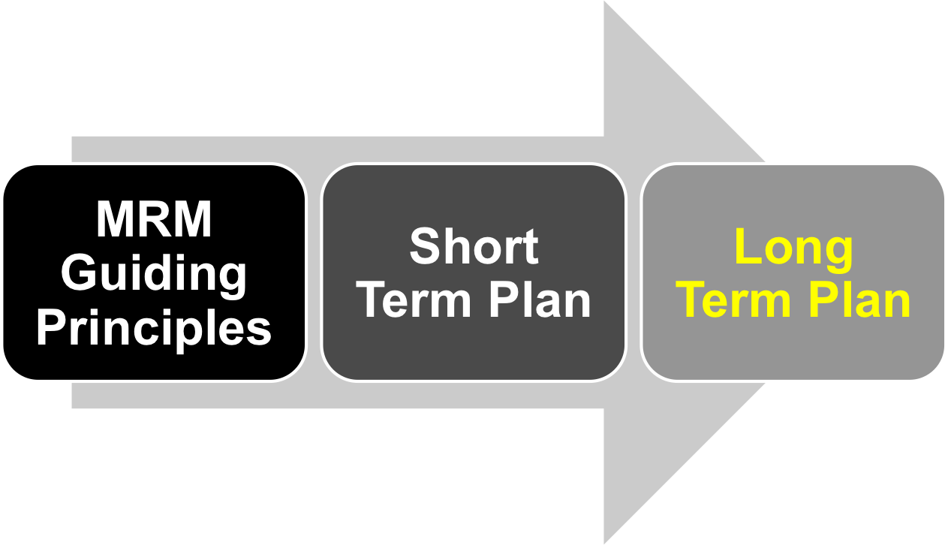
MRM Business Model
2011-04-29
MRMv2 Steering Committee

Slide 25
Long Term Plan:
Opportunities for Investigation
e-Solutions contract or alternative hosting arrangement (e.g. IBM Cloud)
IBM Software Renewal (will IBM waive all or part of fees?)
Revenue/Royalty arrangement with IBM
Revenue from Training/Consulting Certification and/or course delivery
Government Grants
Joint Councils and/or F/P/T interest/contribution
2011-04-29
MRMv2 Steering Committee

Slide 26
Long Term Plan:
Risks/Added Costs
Additional SA Licenses
Availability of Volunteer Resources
Ongoing viability and costs post-2012
2011-04-29
MRMv2 Steering Committee

Slide 27
Long Term Plan:
Role of Steering Committee
Assist in developing the MRMv2 long term strategy and vision
In 9 -12 months time, hold MRMv2 visioning session
2011-04-29
MRMv2 Steering Committee

Slide 28

Long Term Plan: Lots To Do
MRMv2
2+ years of work
Is just the tip of the
iceberg
We have just begun
2011-04-29
MRMv2 Steering Committee

Slide 29

MRM Business Model
2011-04-29
MRMv2 Steering Committee

